Slide 1
Module 1: Introduction to Relational Databases
COMP 2714 – Relational Database Systems
Learning Outcome: LO1 – Describe the functions and characteristics of the relational database model
Notes:
Welcome students. Introduce course and Module 1 objectives.

Slide 2
What you will learn …
At the end of this class you will be able to:
Define the difference between data and information
See how modern databases evolved from file systems
Understand flaws in file system data management
Describe what a database is, various types of database, and why they are valuable assets for decision making
Explain the importance of database design
Outline the main components of the database system
Describe the main functions of a database management system (DBMS)

Slide 3

Everybody is talking about Data!
Why is it that data & information have become so important?
Data is nothing extraordinary - everything that captures our attention and is relevant to us to know is data.
We, as humans have to have information to make decisions.
But what is information and what do we exactly mean by data?
Notes:
Examples:
Government has invested in open data initiatives
A lot of companies want to use data to make better decisions
People love data visualizations
Ask them to give examples of Data & Information
This could work as pretest.

Slide 4
Data & Information
Data are the raw facts
Information is the result of processing raw data to reveal its meaning
To produce information you need to start with a question
How do we store, process and manage data and information?
Notes:
Exploration to reveal the patterns
Predication and Inference using statistical modelling
to reveal meaning information needs context
A data summary that answers your question is meaningful. It provides information and insight into the raw data.
Connecting back to initial survey / My questions

Slide 5
Why Databases?
We need information to make better decisions
Our brain has evolved to create categories of information and then somehow link them together, building a structure
Our memory accesses the data & information we need through these structures
With Relational Database Design, we are trying to do (for the computer) what our brain does naturally: defining structures for storing data to make finding, changing and managing information more seamless, efficient and reliable.
Notes:
We need data, there is so much data, we need a system to help us.
Buzz, Buzz: Decision Support, Operations Research, and data science all require skills that you will learn in this course

Slide 6
Databases are the tool for data & information storage and management. They have evolved over decades to respond to our information needs.
Notes:
We won’t understand the importance of databases and the type of problems they tackle, unless we review the file system approach to information storage and management.

Slide 7
Evolution of File System Data Processing
Manual file systems
Accomplished through a system of file folders and filing cabinets
Computerized file systems
Data processing (DP) specialist created a computer-based system to track data and produce required reports
Modern end-user productivity tools (kind of going back to file systems! )
Includes spreadsheet programs such as Microsoft Excel
Notes:
Before database systems, there were file systems.
Redux means returned, brought back, revived.

Slide 8
Problems with File System Data Processing
Lengthy development times
Difficulty of getting quick answers
Complex system administration
Lack of security and limited data sharing
Extensive programming
Notes:
Lengthy development times
DP had to write a program even for the simplest data-retrieval.
The programer had to identify what needs to be done and how
Modern databases use a non-procedural data manipulation language that allows the use to specify what must be done without specifying how.
Difficulty of getting quick answers
Complex system administration: The file system method requires file management programs to access and manipulate data.
Each file needs its own management program
there are many files
each department owns their own data
all this make the administration of data difficult
Lack of security and limited data sharing
Security and data sharing are closely related
security measures are difficult to implements
the file system application provide rudimentary security features but even those are often not used
security features include password protection, locking parts of the data or the management system and maintaining the confidentiality of data
Hardship in managing security leads to limited data sharing
Extensive programming
Any minor change to the structure of the file, needs a change in all the programs that use that file (the data management programs)
these extensive changes lead to errors / bugs which in turn need debugging programs
These limitations lead to structural and data dependence

Slide 9
Structural and Data Dependence (1 of 2)
Structural dependence
Access to a file is dependent on its own structure
All file system programs are modified to conform to a new file structure
Structural independence
File structure is changed without affecting the application’s ability to access the data

Slide 10
Structural and Data Dependence (2 of 2)
Data dependence
Data access changes when data storage characteristics change
Data independence
Data storage characteristics are changed without affecting the program’s ability to access the data
Notes:
Logical - how we think about it.
Physical - how it is actually done by the computer.
When we have data dependence, we always have to worry about how the computer actually does it. And cannot think in a higher level of abstraction.

Slide 11
Practical significance of data dependence is the difference between logical and physical format
Notes:
For the user to experience data independence, the DB designer needs to translate from logical format to physical format. And make the storage, access and management still work even after the data type is changed.

Slide 12
Logical & Physical Data Format
Logical data format is how humans view the data
Physical data format is how the computer must work with the data
Data dependence makes managing the file system extremely cumbersome
Every file access program must tell the computer not only what to do but also how to do it
Notes:
therefore the file management programs need to know how to open a specific file, they need to know the specifications of the records in that file and the definition of the fields to be able to work with the file. Data dependence makes managing the file system extremely cumbersome for the programmer and database manager as they need to mediate between the logical data format and physical data format to be able to tell the computer how to do things.

Slide 13
Data Redundancy (1 of 2)
It is difficult to combine data from different sources in a file system environment
Often different users/ departments keep their own copy of the data (islands of information)
these data are not consistently updated and each contain a slightly different version of the same data
Data Redundancy: when the same data is unnecessarily kept at different locations

Slide 14
Data Redundancy (2 of 2)
Possible results of uncontrolled data redundancy
Poor data security
Data inconsistency
Data-entry errors
Data integrity problems
Notes:
poor data security: multiple versions of the data increases the risk of data exposed to unauthorized access
data inconsistency: data in multiple places needs updating multiple places
data entry errors: more places to edit, more chances to make mistakes
data integrity problems: maybe this becomes more clear with an example. take the customer and agent files. Each agent is a customer. but it is possible to enter into the agent’s file a non-existing customer.

Slide 15
Data Integrity
Data Integrity is present when the data corresponds to reality. that the data is accurate and consistent. data integrity is closely related to data consistency.

Slide 16
Data Anomalies
Develops when not all of the required changes in the redundant data are made successfully. e.g:
Update anomalies
Insertion anomalies
Deletion anomalies

Slide 17
Database Systems
the file system consists of many separate and unrelated files
appears to the end user, as a single logical unit
Enables end user to only think of what to do and not how to do it.
DBMS eliminates data inconsistencies, data anomaly, data dependence and structural dependence problems, if the database is designed properly.
DBMS stores the data structures, relationships between structures, and access paths
Notes:
but what is a DBMS really? and how does it fit into the picture?
To answer this question we need to learn the components that build up a complete database system.

Slide 18
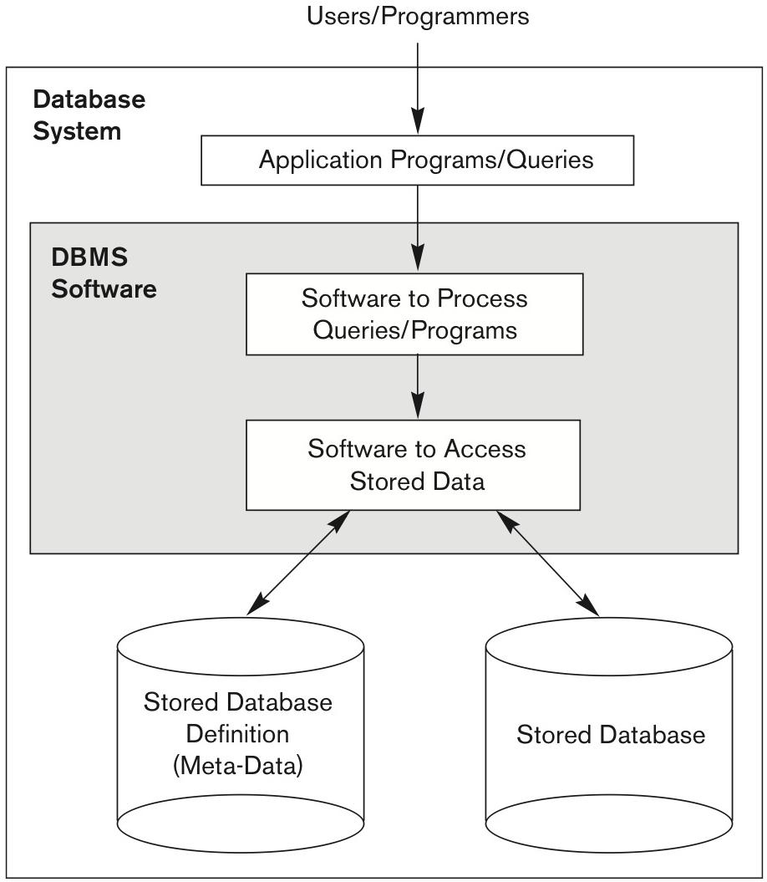
Database Defined
Database:
A shared, integrated computer structure that houses a collection of related data.
contains two types of data: end-user data (raw facts) and metadata.
Metadata:
Data about data; that is, data about data characteristics and relationships.

Slide 19
DBMS Defined
collection of programs that manages the database structure and controls access to the data stored in the database.
acts as an intermediary between the end use and the database hiding much of the database internal complexity and presents the use with a single, integrated view of the data.
Access to the database is only through the DBMS
makes it possible to share data across multiple applications

Slide 20
DBMS Functions (1 of 3)
Data dictionary management
Data dictionary: stores definitions of data elements and their relationships
Data storage management
Performance tuning ensures efficient performance
Data transformation and presentation
Data is formatted to conform to logical expectations

Slide 21
DBMS Functions (2 of 3)
Security management
Enforces user security and data privacy
Multi User access control
Sophisticated algorithms ensure that multiple users can access the database concurrently without compromising its integrity
Backup and recovery management
Enables recovery of the database after a failure

Slide 22
DBMS Functions (3 of 3)
Data integrity management
Minimizes redundancy and maximizes consistency
Database access languages and application programming interfaces
Query language: lets the user specify what must be done without having to specify how
Structured Query Language (SQL): de facto query language and data access standard supported by the majority of DBMS vendors
Database communication interfaces
Accept end-user requests via multiple, different network environments

Slide 23
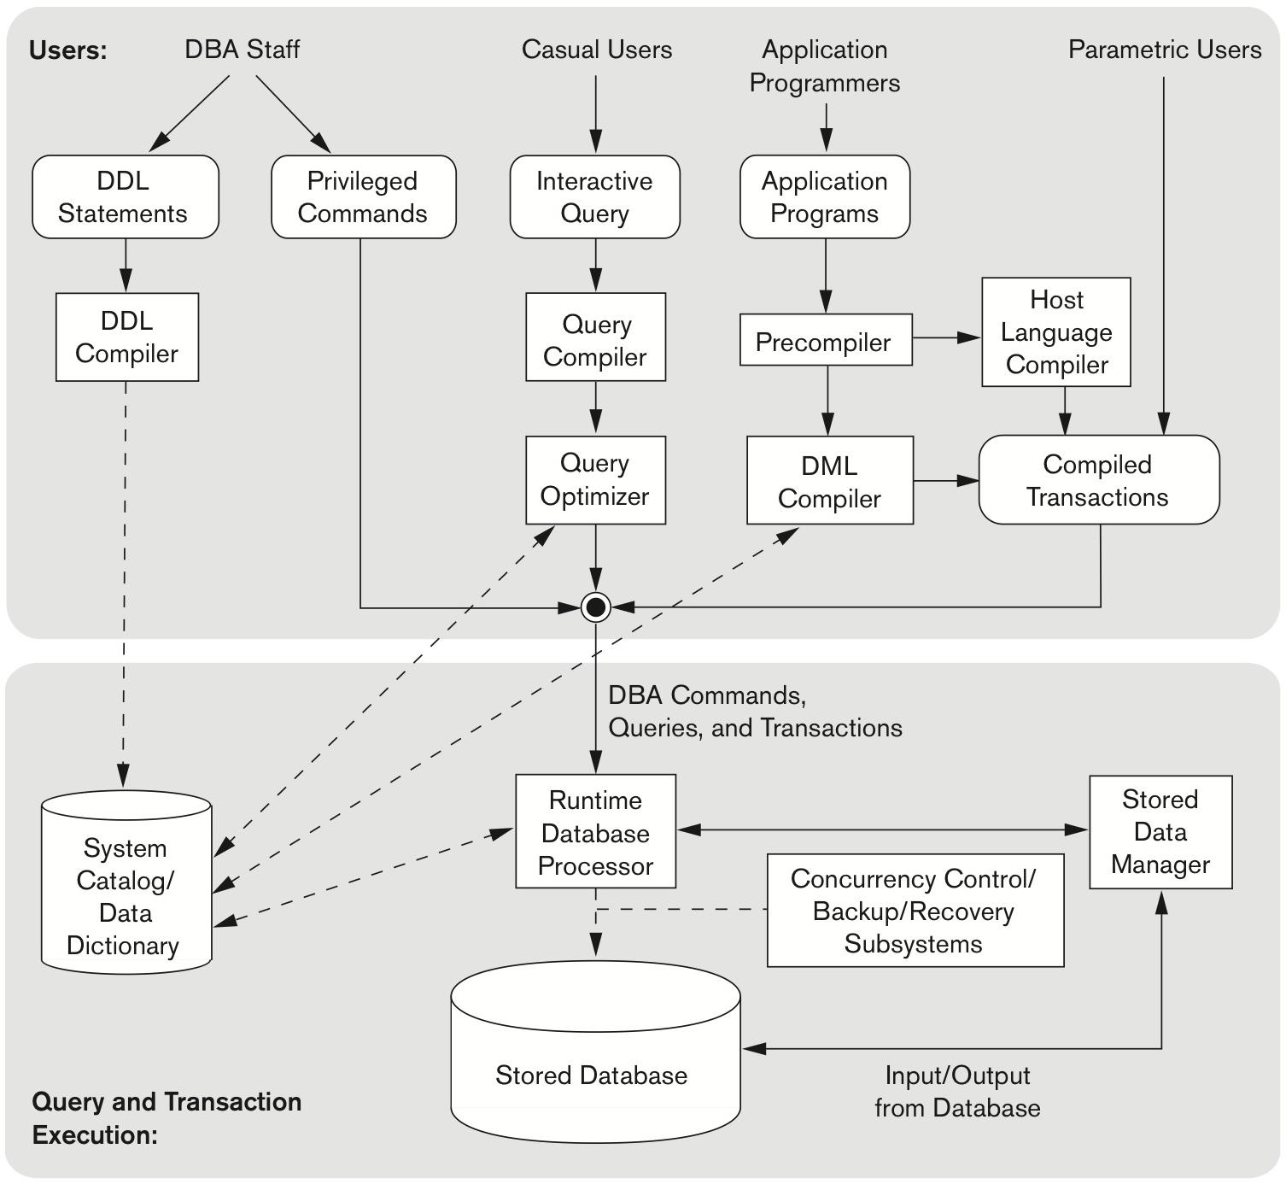
The Database System Environment
Database system: organization of components that define and regulate the collection, storage, management, and use of data within a database environment
Hardware
Software
People
Procedures
Data

Slide 24
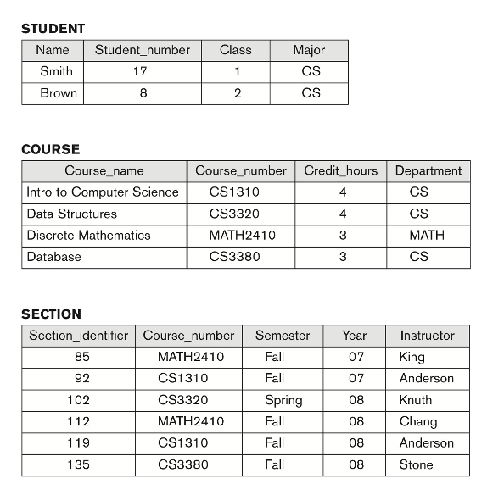
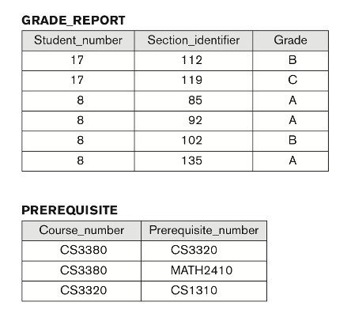
Mini-world Example
Notes:
Introduce example that will recur.

Slide 25
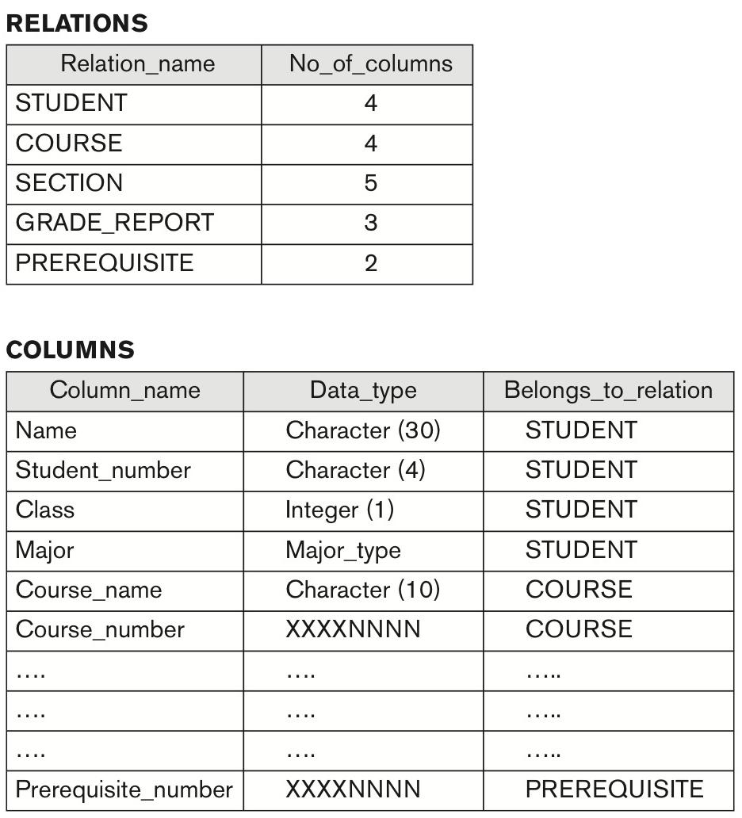
Metadata & Catalog
Metadata = data about data
Catalog stores schema, constraints, data types
Notes:
Explain why metadata matters (self-describing).

Slide 26
Database Users – Actors on the Scene
DBAs: manage system, authorize access
Designers: define structure and constraints
End users: casual, naive, sophisticated, standalone
Notes:
Explain categories with examples.

Slide 27
Database Users – Behind the Scene
System implementors
Tool developers
Operators/maintenance staff
Notes:
Mention behind-the-scenes contributors.

Slide 28
Why Database Design is Important
People naturally have a “narrow” view of the data in their environment.
this narrow view and lack of proper data modelling and database design skills leads to poor database design choices which is typical in spreadsheet and and desktop database programs (e.g. MS Access)
Database Design, is to build the structure that facilitates storing and managing end-user data. So it meets all user requirements.
Even a good DBMS performs poorly with a badly designed database
To properly design a database we must first precisely identify databases expected use

Slide 29
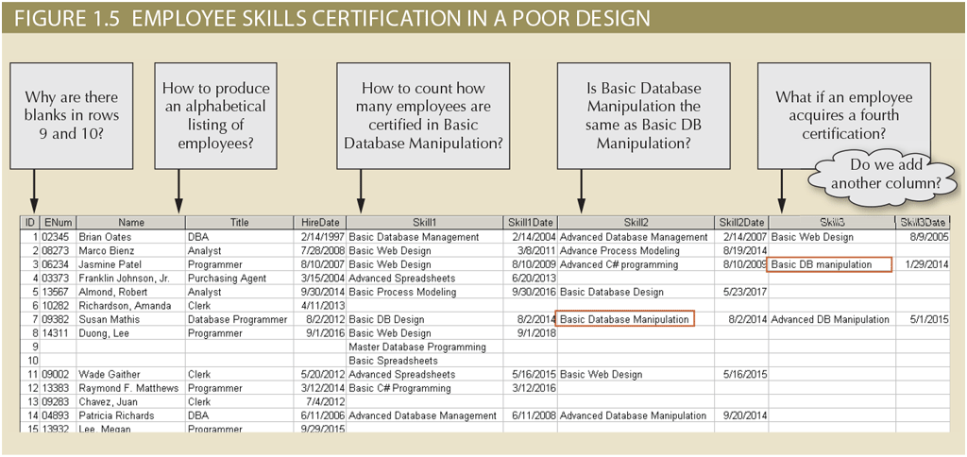

Slide 30
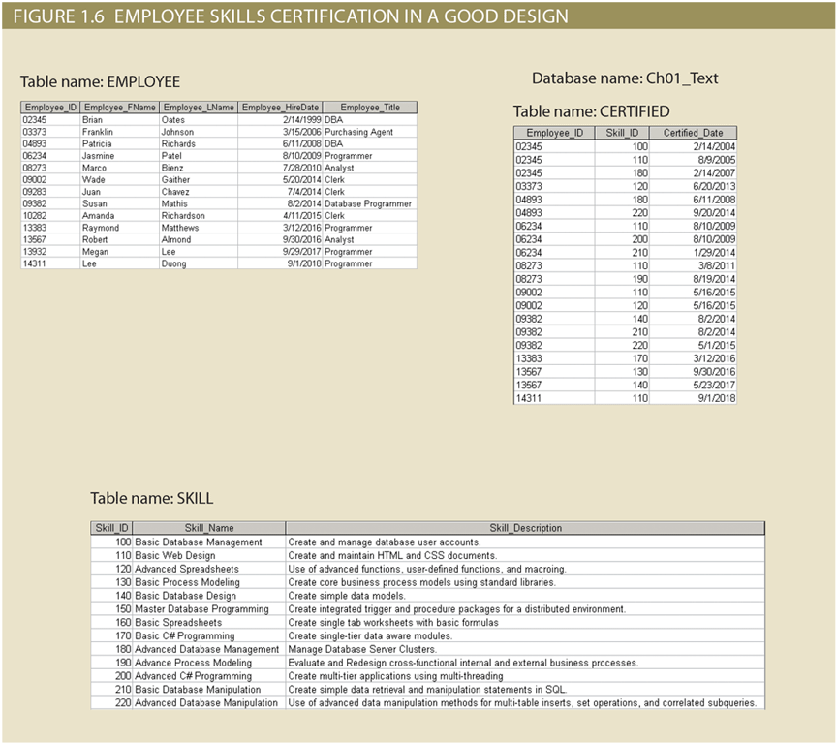

Slide 31
Database design is a process of decomposition: the integrated data must be decomposed into its constituent parts. each part stored in its own table

Slide 32
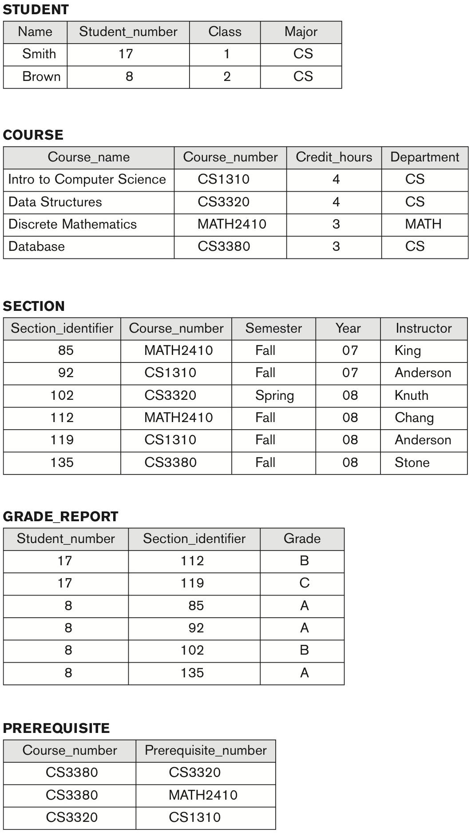
Relational Model Basics
Relation (table) = set of tuples (rows) with attributes (columns)
Tuple (row) = record of data
Attribute (column) = property with a domain (data type)
Notes:
Introduce relational terminology.

Slide 33
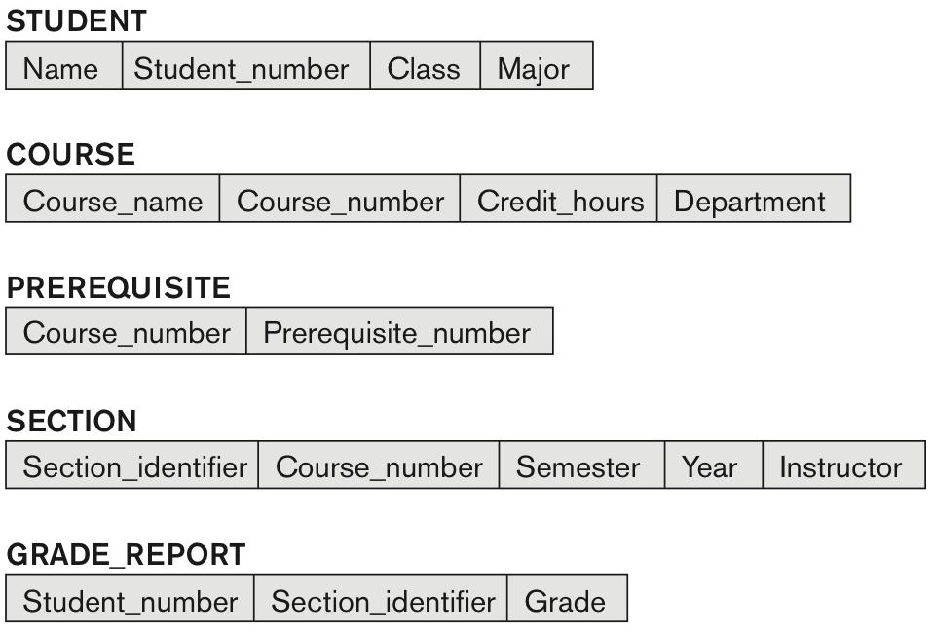
Keys in the Relational Model
Primary key = unique identifier
Candidate keys = alternative choices
Foreign key = reference to another relation
Notes:
Point out PKs and FKs in schema diagram.

Slide 34
Integrity Constraints
Entity integrity: no NULL in primary keys
Referential integrity: foreign keys must match primary keys
Notes:
Use schema diagram arrows to explain constraints.

Slide 35
Schemas vs Instances
Schema = description (changes rarely)
Instance = data state (changes frequently)
Schema = intension, Instance = extension
Notes:
Explain with analogy: blueprint vs current house state.

Slide 36
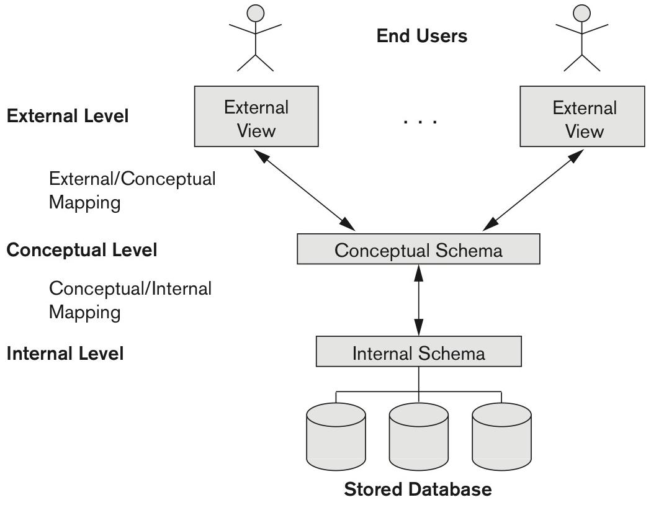
Data Independence & Three-Schema Architecture
Logical: change conceptual schema without affecting views
Physical: change internal storage without affecting schema
Notes:
Show flexibility in design.

